Slide 1
Baseline (0.064, 0.032, 0) and RWC Comparison (0.097) for Beta1 Phase 2

Slide 2
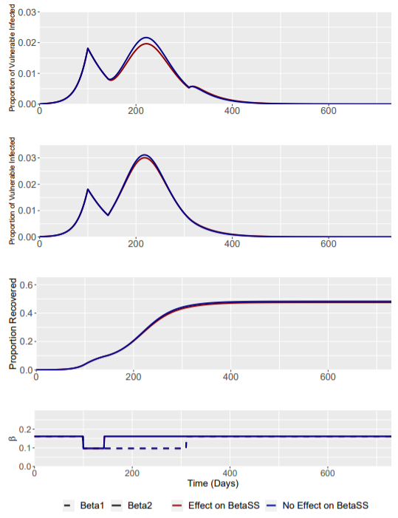
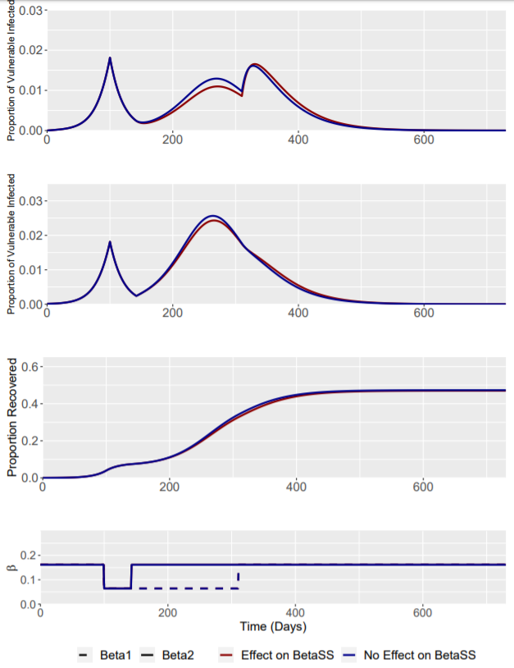
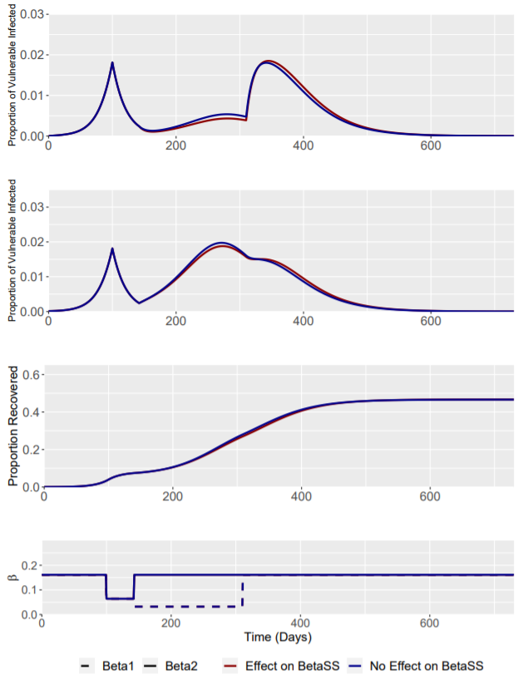
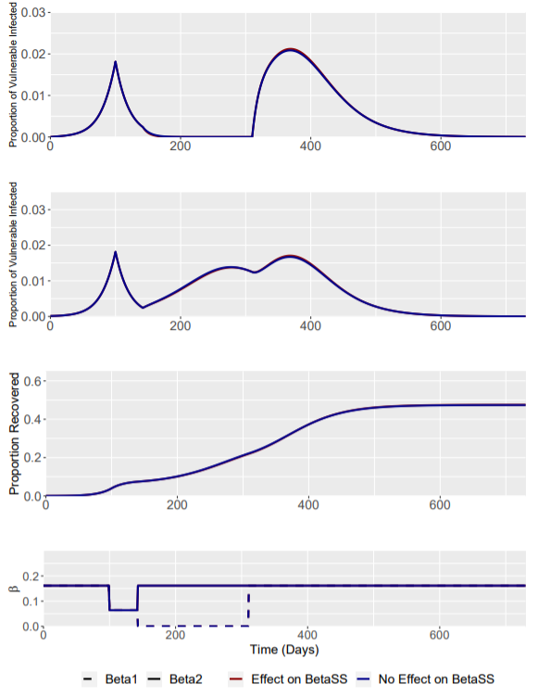
No Effect of Intervention on β_{SS}
Removing the effect of the intervention on β_{SS} transmission has very little effect on the overall model transmission dynamics.
NOTE THAT SECOND ROW IS NON-VULNERABLE
RWC Phase 1 (Beta1 = 0.097)
RWC Phase 2 (Beta1 = 0.097)
Phase 2 (Beta1 = 0.064)
Phase 2 (Beta1 = 0.032)
Phase 2 (Beta1 = 0)

Slide 3
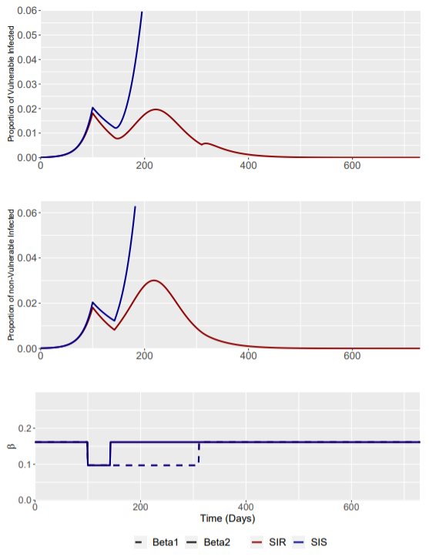
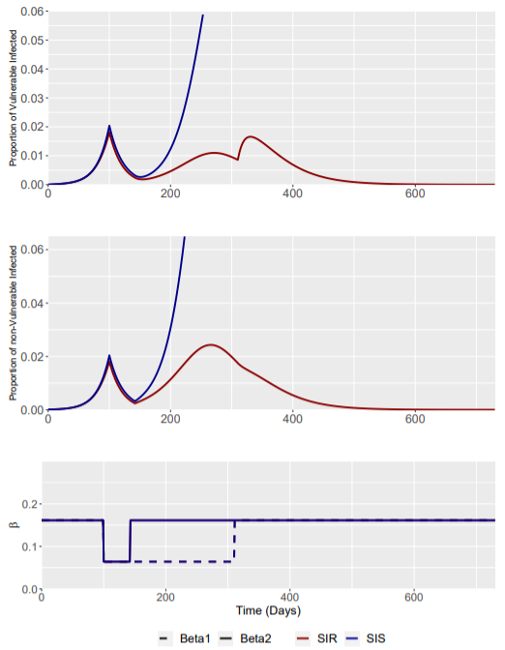
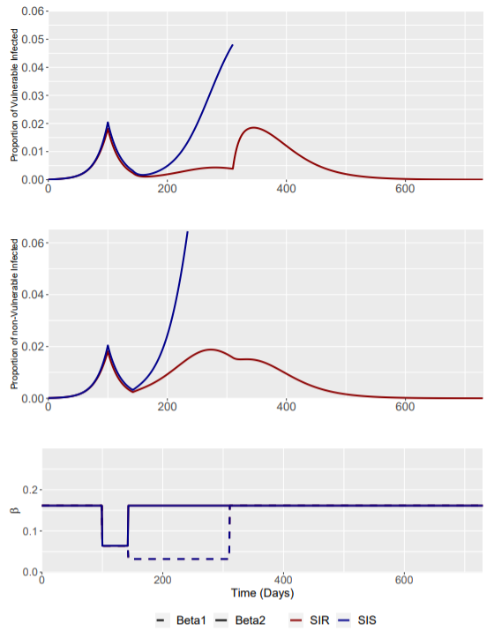
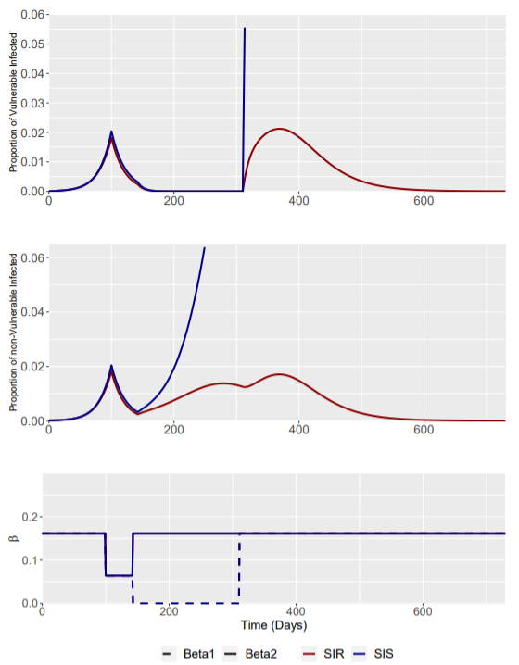
SIS vs SIR Model
The loss of immunity has significant effects on the transmission dynamics of the modelled disease.
Interventions are now unable to control the epidemic “curve” – the epidemic accelerates and overwhelms health systems.
Some figures appear to “end” early – this is because the next time point I(t) (often after intervention is released) is beyond the y-axis limits (0.06 and 0.065)
RWC Phase 1 (Beta1 = 0.097)
RWC Phase 2 (Beta1 = 0.097)
Phase 2 (Beta1 = 0.064)
Phase 2 (Beta1 = 0.032)
Phase 2 (Beta1 = 0)

Slide 4
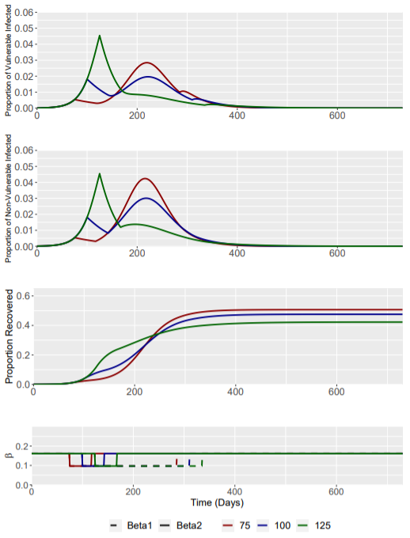
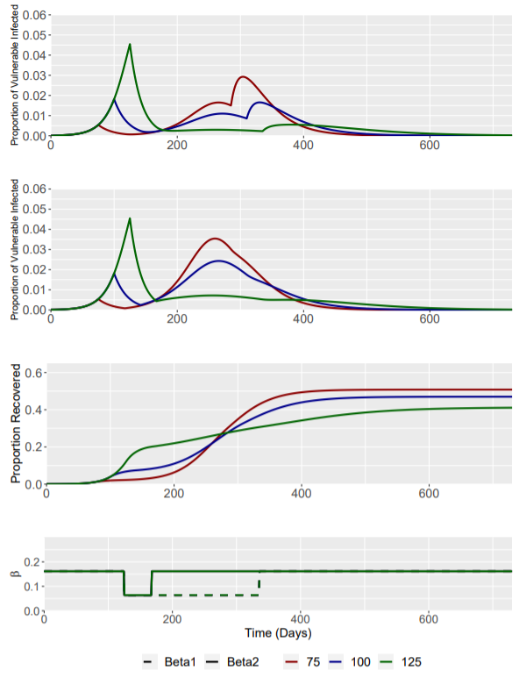
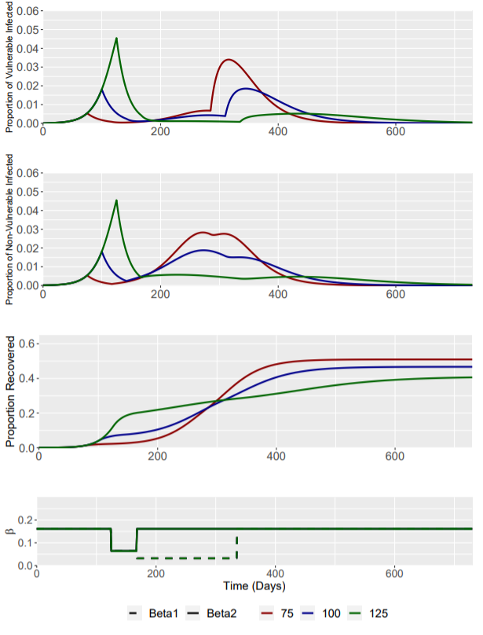
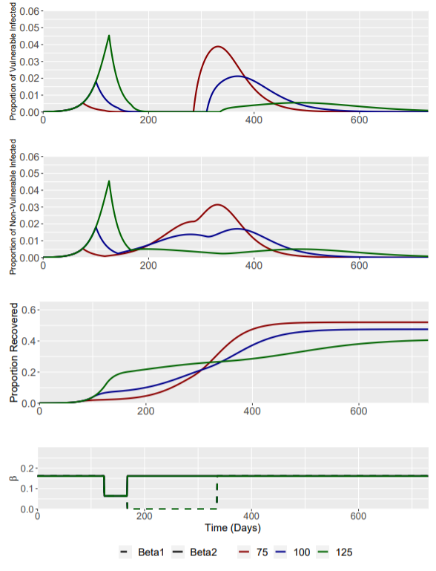
Different Intervention Triggers – I(t) = 0.0054 (day 75), 0.0182 (day 100) and 0.0454 (day 125)
RWC Phase 1 (Beta1 = 0.097)
RWC Phase 2 (Beta1 = 0.097)
Phase 2 (Beta1 = 0.064)
Phase 2 (Beta1 = 0.032)
Phase 2 (Beta1 = 0)

Slide 5
ONLY RWC Comparison (0.097, 0.049, 0) for Beta1 Phase 2

Slide 6
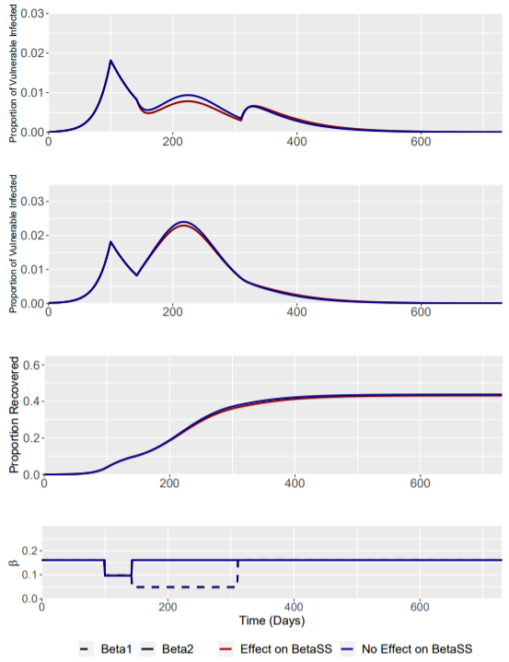
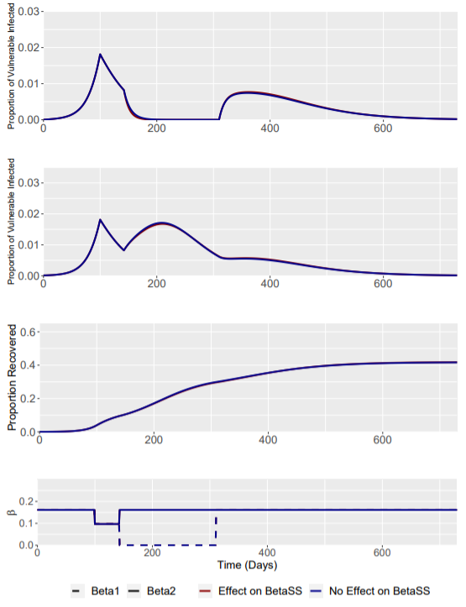
No Effect of Intervention on β_{SS}
Removing the effect of the intervention on β_{SS} transmission has very little effect on the overall model transmission dynamics.
NOTE THAT SECOND ROW IS NON-VULNERABLE
RWC Phase 2 (Beta1 = 0.097)
RWC Phase 2 (Beta1 = 0.049)
RWC Phase 2 (Beta1 = 0)

Slide 7
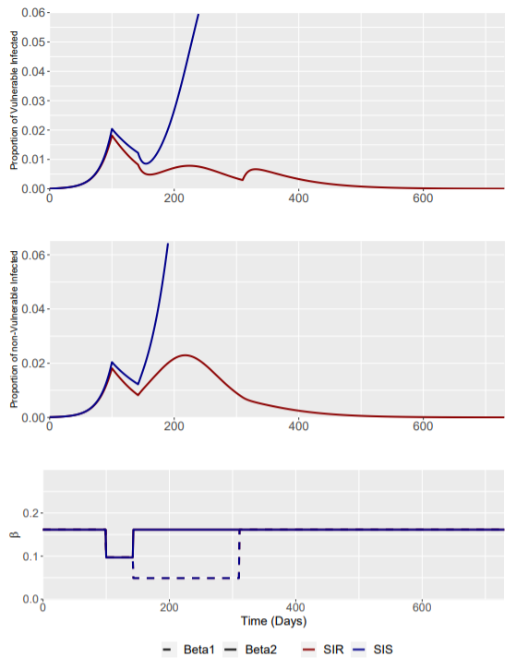
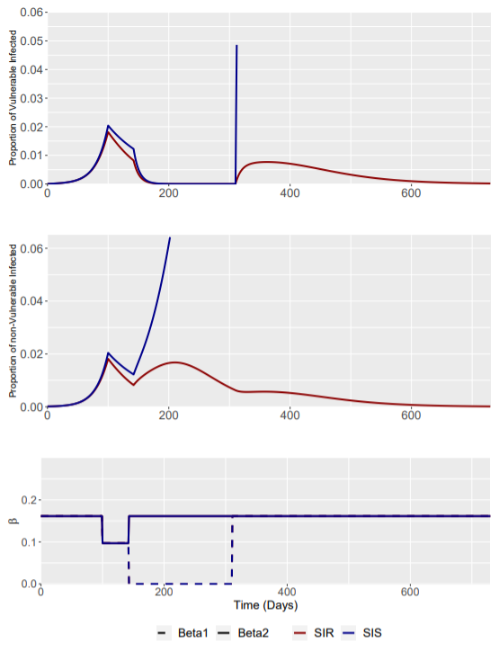
SIS vs SIR Model
The loss of immunity has significant effects on the transmission dynamics of the modelled disease.
Some figures appear to “end” early – this is because the next time point I(t) (often after intervention is released) is beyond the y-axis limits (0.06 and 0.065)
RWC Phase 2 (Beta1 = 0.097)
RWC Phase 2 (Beta1 = 0.049)
RWC Phase 2 (Beta1 = 0)

Slide 8
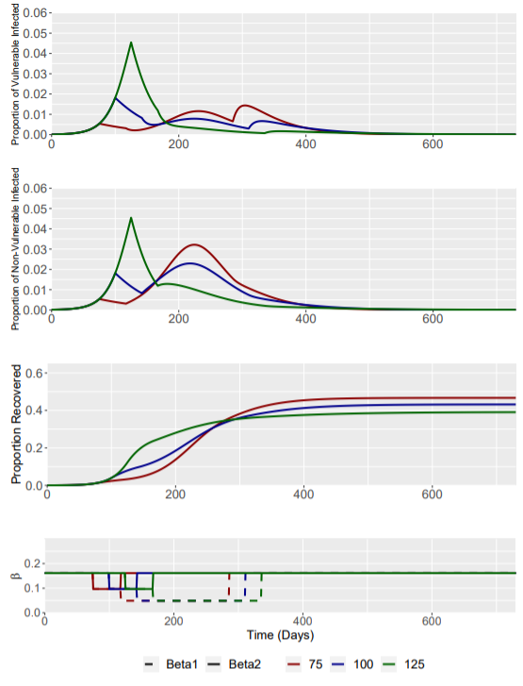
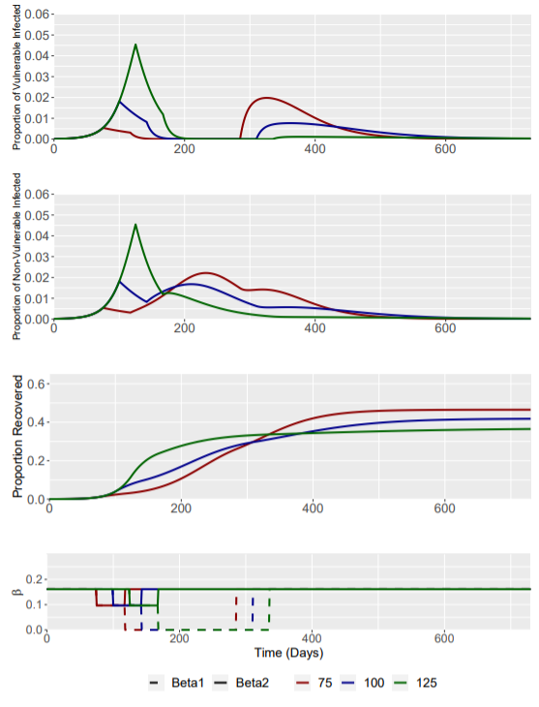
Different Intervention Triggers – I(t) = 0.0054 (day 75), 0.0182 (day 100) and 0.0454 (day 125)
RWC Phase 2 (Beta1 = 0.097)
RWC Phase 2 (Beta1 = 0.049)
RWC Phase 2 (Beta1 = 0)

Slide 9
INDEFINITE LENGTH SIS INTERVENTION

Slide 10
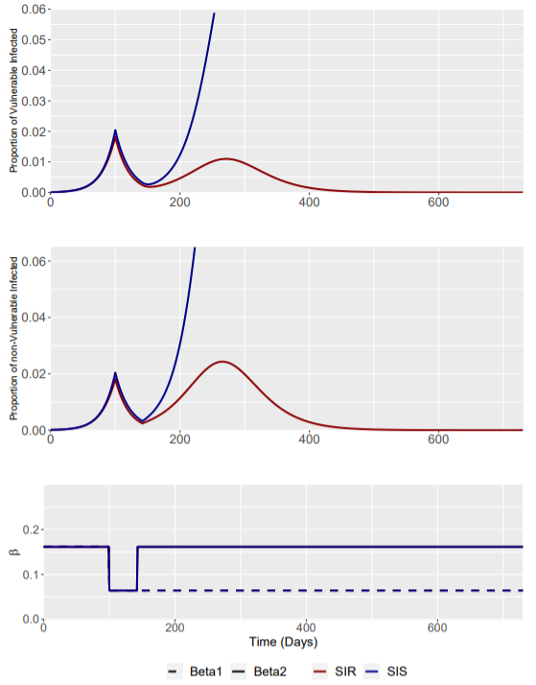
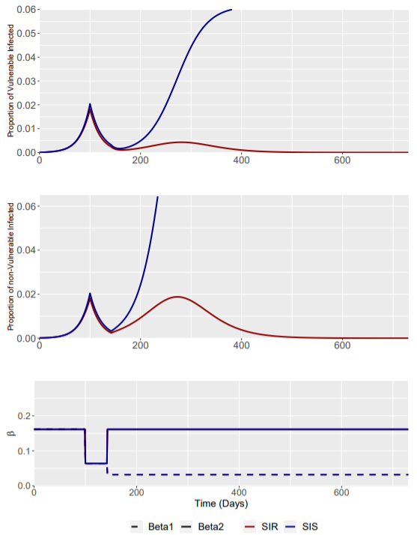
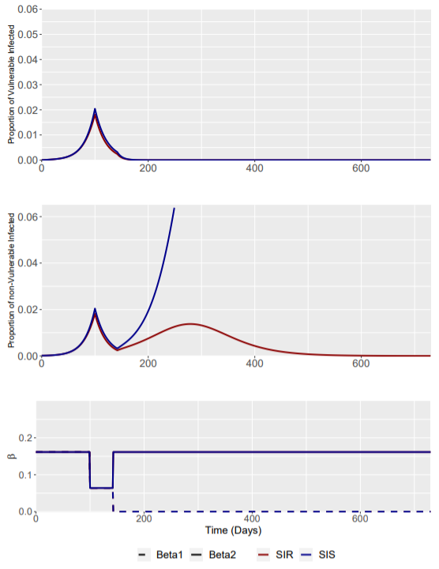
Interventions were assumed to last indefinitely to beta1 (the shielded population).
Only beta1 reductions to 0 were able to prevent Iv(t) increasing above 0.0182 – However, sustaining an intervention of this magnitude indefinitely is extremely difficult.
RWC Phase 2 (Beta1 = 0.064)
RWC Phase 2 (Beta1 = 0.032)
RWC Phase 2 (Beta1 = 0)

